Slide 1
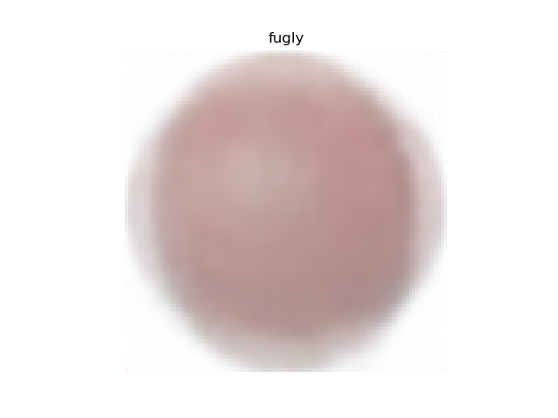
Fruit 2: Electric Boogaloo
Jeremy Dohmann

Slide 2
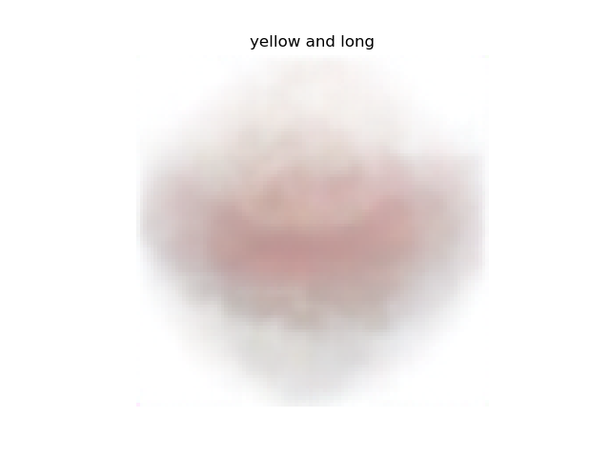
Challenge
Produce novel fruits from visual descriptions
Generalize to new fruits and descriptions
Learn specific visual properties: color, shape size

Slide 3
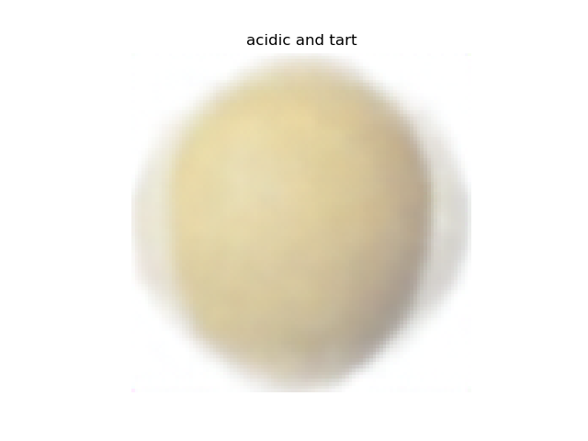
Motivation
Image captioning maps images to text but seldom dives below the object class level
What if we are interested in learning the visual attributes that make define an object class?
Existing fruits are too boring, would be cool to see some new fruits

Slide 4
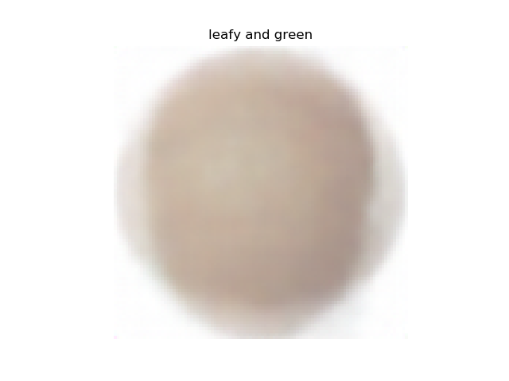
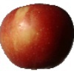
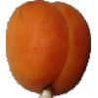
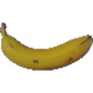
The data set
Fruits 360 Image set: restricted to 90 classes, ~60,000 images
Descriptions pulled from specialtyproduce.com:
“About the size of an egg, it is wrapped in a russet-brown thin skin with short rather stiff hairs. The kaleidoscope-like…”

Slide 5
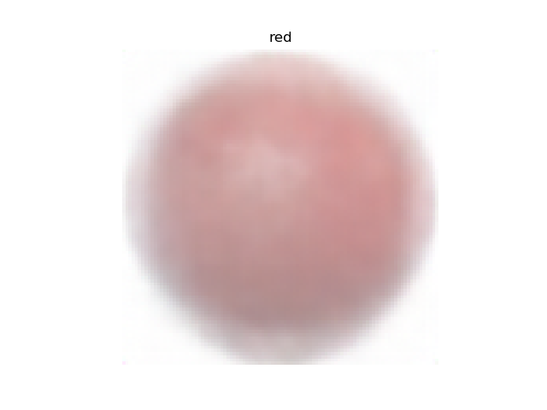
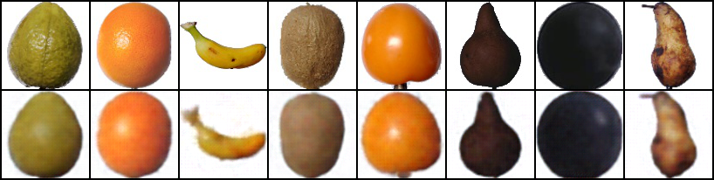
Approach
Train ConvNet VAE mapping Images to Images

Slide 6
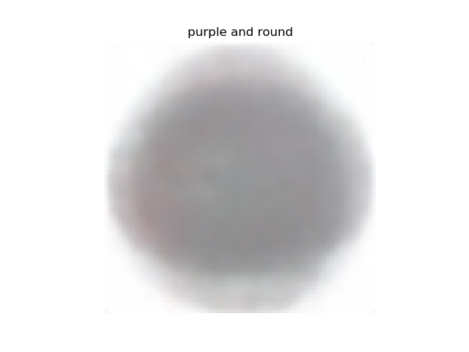
Approach
Train ConvNet VAE mapping Images to Images
Embed descriptions using BoW unigrams/bigrams

Slide 7
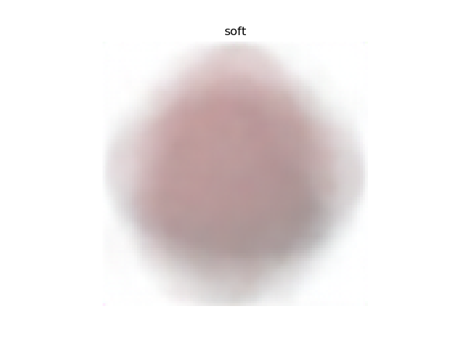
Approach
Train ConvNet VAE mapping Images to Images
Embed descriptions using BoW unigrams/bigrams
Pretrain feedforward network to predict last encoding layer from Image VAE
Connect pretrained text encoder from 3.) to decoder from 1.)

Slide 8
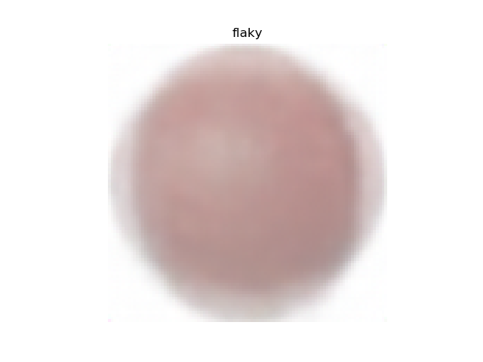
Approach
Train ConvNet VAE mapping Images to Images
Embed descriptions using BoW unigrams/bigrams
Pretrain feedforward network to predict last encoding layer from Image VAE
Connect pretrained text encoder from 3.) to decoder from 1.)
Retrain 4.)

Slide 9

Problems
Fruits appear in many different poses
Only 90 text descriptions (the feedforward text encoder over fits)
Text descriptions contain spurious information/aren’t concise (e.g. growing conditions, comparisons to other fruits, etc.)

Slide 10
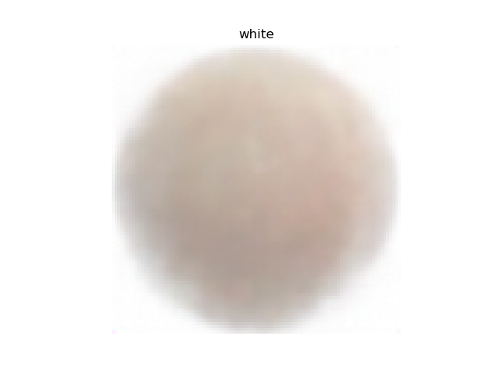
Problems/Solutions
Fruits appear in many different poses /
Add random vectors to overfit poses of training images
Only 90 text descriptions (the feedforward text encoder over fits)
Add new object classes
Reduce complexity of encoding (BoW)
Design more continuous encoding space for text
Text descriptions contain spurious information/aren’t concise (e.g. growing conditions, comparisons to other fruits, etc.)
Make custom, handwritten descriptions

Slide 11

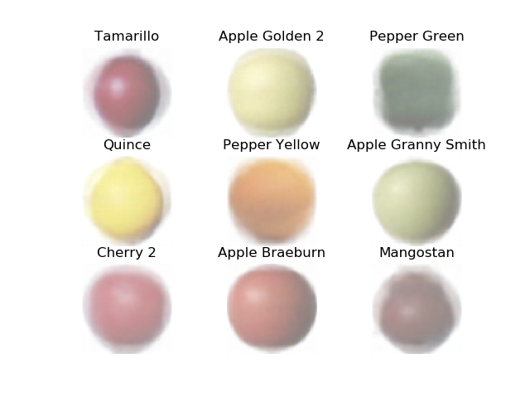
Results
High fidelity on training fruits

Slide 12
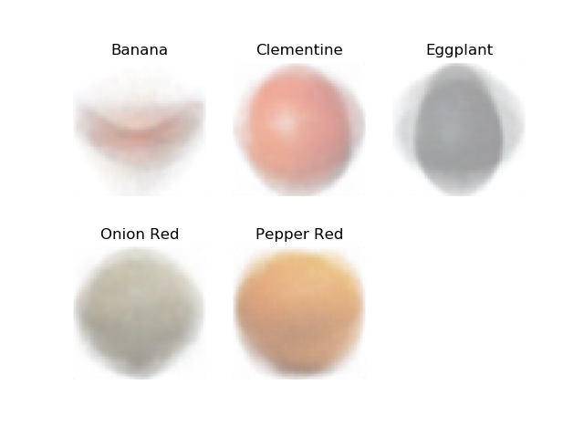
Results
Signs of overfitting on test

Slide 13
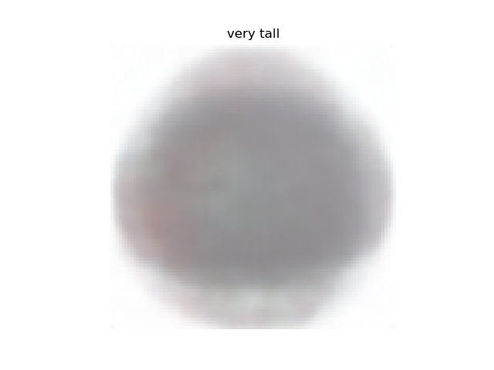
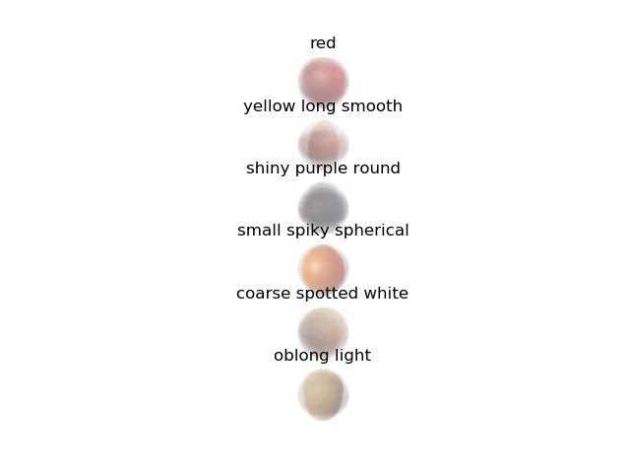
Results
Some ability to learn from novel descriptions

Slide 14
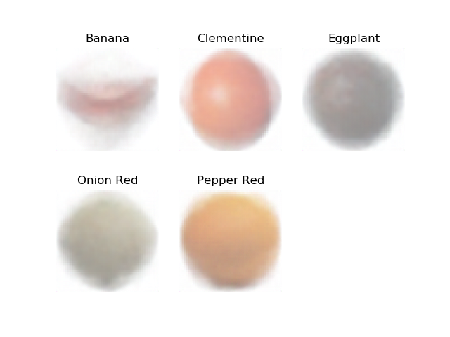
Results
Overfitting random appended vectors improves pose and shape
With random noise
Without random noise

Slide 15
Room for improvement
More concise descriptions
More object classes
More continuous text embeddings
Improvement on training procedure (e.g. augment definitions using other text sources)

